Slide 1
Week 10-11 IT166 Python for Data Science & Data Analytics Time Series
The goal of this class is to turn data into information, and information into insight that leads to do informed decisions.

Slide 2
About Time Series
It is an important form of structured data in many different fields, like finance, economics, ecology, etc.
Anything that is observed or measured at many points in time forms a time series.

Slide 3
Timestamps
A timestamp is a specific instant in time.
A timestamp can be a year, a quarter, a month, a day, an hour, a minute, or a second.

Slide 4
Time series in pandas
Recall the two data types in pandas we have learned: Series and DataFrame.
Series can be used to denote a single time series, where one timestamp is associated with only one value.
DataFrame can be used to denote a multiple time series, where one timestamp is associated with multiple values.

Slide 5
About quarter
Quarter, as a timestamp, is a three-month period.
Most of the universities in the states use semester-based academic calendars (semester systems), but there are some universities use quarter systems.
Quarter is also widely used for companies to refer to their fiscal years.

Slide 6
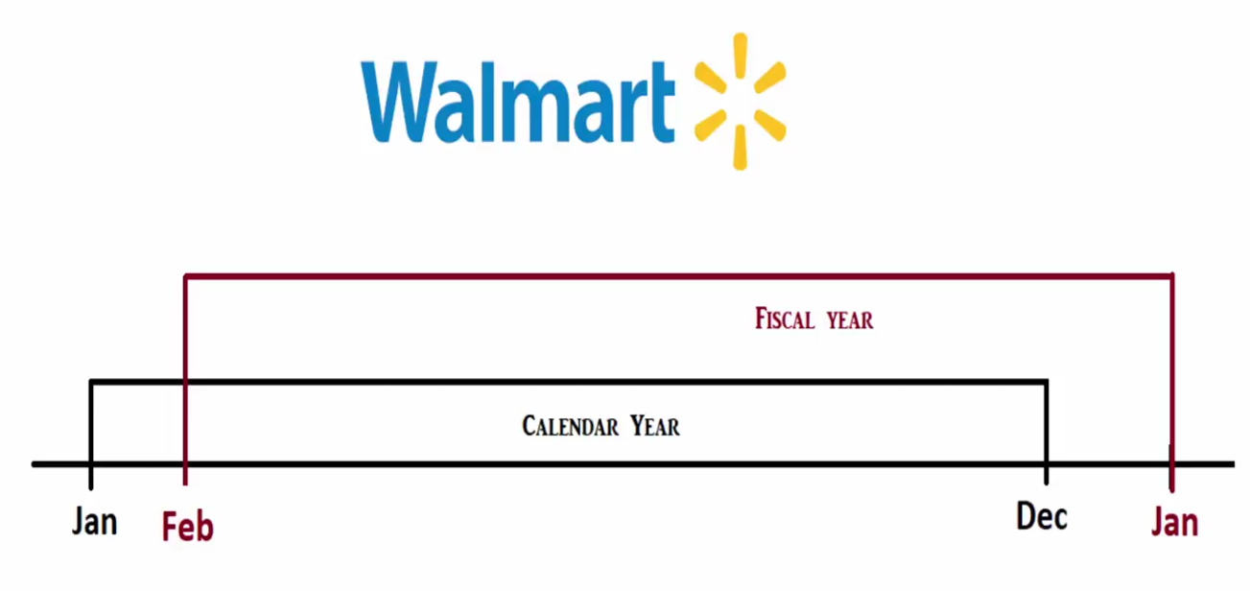
About quarter
The fiscal year is always later than the calendar year. For instance, using the above Walmart example, if the calendar year is 2018, then the fiscal year is 2019.
Then:
2019Q1: 02/01/2018 -- 04/30/2018; 2019Q2: 05/01/2018 -- 07/01/2018; 2019Q3: 08/01/2018 – 10/31/2018; 2019Q4: 11/01/2018 – 01/31/2019

Slide 7
Time series forecasting using ARIMA

Slide 8
ARIMA model
ARIMA is an acronym that stands for AutoRegressive Integrated Moving Average.
It is a class of statistical models for analyzing and forecasting time series data.

Slide 9
ARIMA descriptions
AR: Autoregression, a model that uses the dependent relationship between an observation and some number of lagged observations.
I: Integrated, the use of differencing of raw observations (ex.: subtracting an observation from an observation at the previous time step) in order to make the time series stationary.
MA: Moving Average, a model that uses the dependency between an observation and a residual error from a moving average model applied to lagged observations.

Slide 10
ARIMA descriptions
Each of those components, AR, I, and MA, are explicitly specified in the model as a parameter.
A standard notion is used at ARIMA(p,d,q).
The parameters, p, d, and q are defined as follows:
p: The number of lag observations included in the model, also called the lag order.
d: The number of times that the raw observations are differenced, also known as the degree of differencing.
q: The size of the moving average window, also called the order of moving average.
A value 0 can be used as a parameter, which indicates to not use that element of the model. This allows the ARIMA model to be configured as an ARMA model, or even a simple AR, I, or MA model.

Slide 11
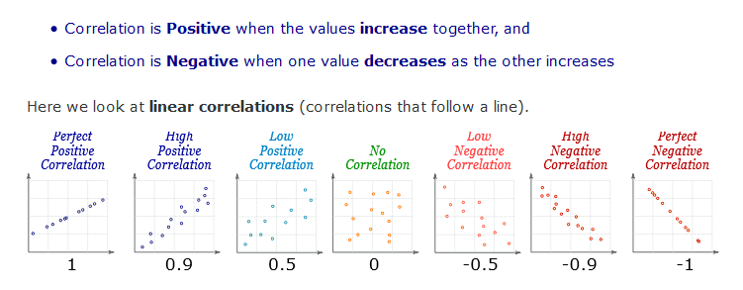
Correlations

Slide 12
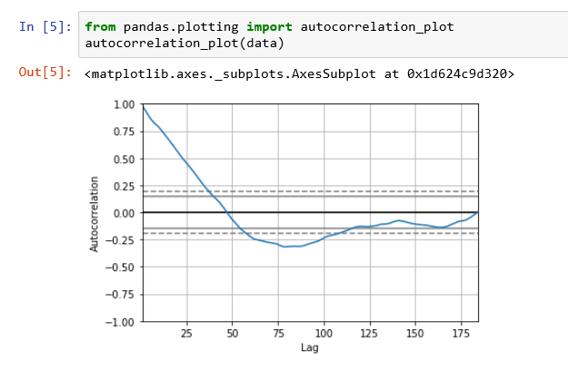
Autocorrelations plot

Slide 13
Questions?
Thank You!!

